Slide 1
R Users Group
November, 2017

Slide 2
Introductions (if new people)
Who are you?
What department/company do you work for?
Why interested in R?

Slide 3
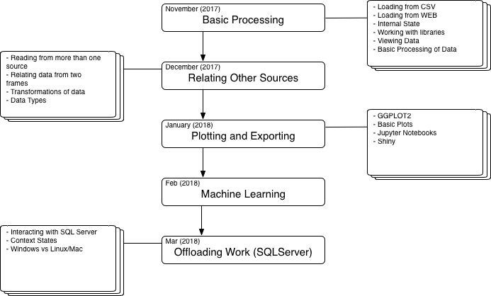
Meeting Structure and Upcoming

Slide 4
Workshop 1 – Basic Processing
If you don’t have a computer, please pair with someone who does
We’ll stop about 11:45 to go over questions and closing remarks
We’ll process from a CSV
Git Repo:

Slide 5
Sensor Information

Slide 6
Sensor Data Overview
Data Point/Name | Type
TimeStamp | DateTime as String (MM/DD/YYYY TT:TT:TT)
Node | Integer
Atmospheric Temperature | Floating Point
Atmospheric Pressure | Floating Point
Atmospheric Humidity | Floating Point
Soil Temperature | Floating Point
Raw Soil Moisture 20 cm | Integer
Raw Soil Moisture 5 cm | Integer
Voltage | Floating Point
Soil Moisture Percentage 20 cm | Floating Point
Soil Moisture Percentage 5 cm | Floating Point
Signal | Integer

Slide 7
Exercise Details
Data:
Questions/Exercises
Load the data
Data Structures
Data Frames
Data.Table
Array/Matrix/List/etc
Basic Groupings and Analysis
Average moisture per X period (day, week, month) per node
Average humidity per X period (day, week, month) per node
Average Atmospheric Pressure per X period (day, week, month) per node.
Signal Variation (time of day?)
General guess on topology of this farm looking at data?

